Slide 1

Where are all the jobs with the highest salaries in India?
By: Chris

Slide 2
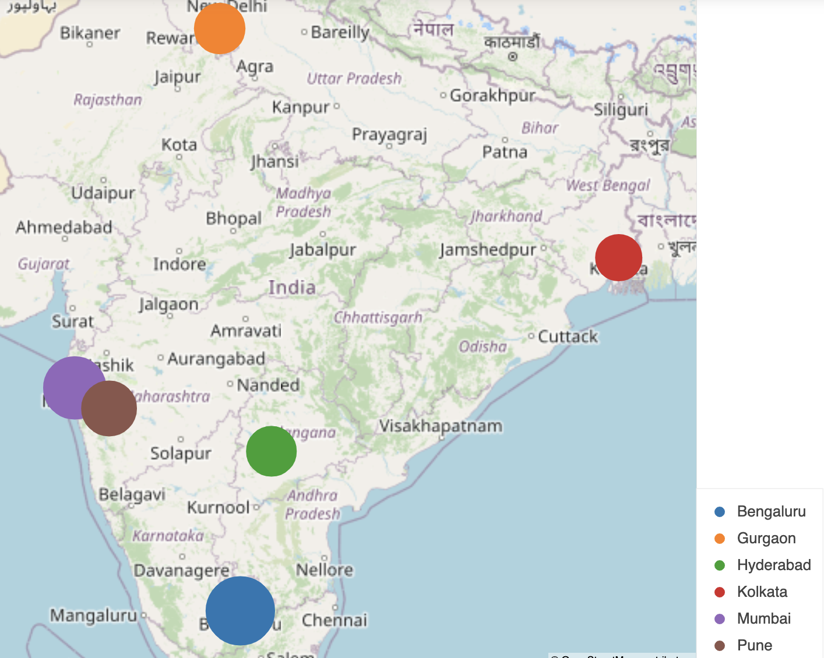
Top Location to search for employment
Top locations in India to look for jobs in order:
Bengaluru → 70
Mumbai → 58
Pune → 45
Gurgaon → 38
Hyderabad → 37
Kolkata → 32

Slide 3
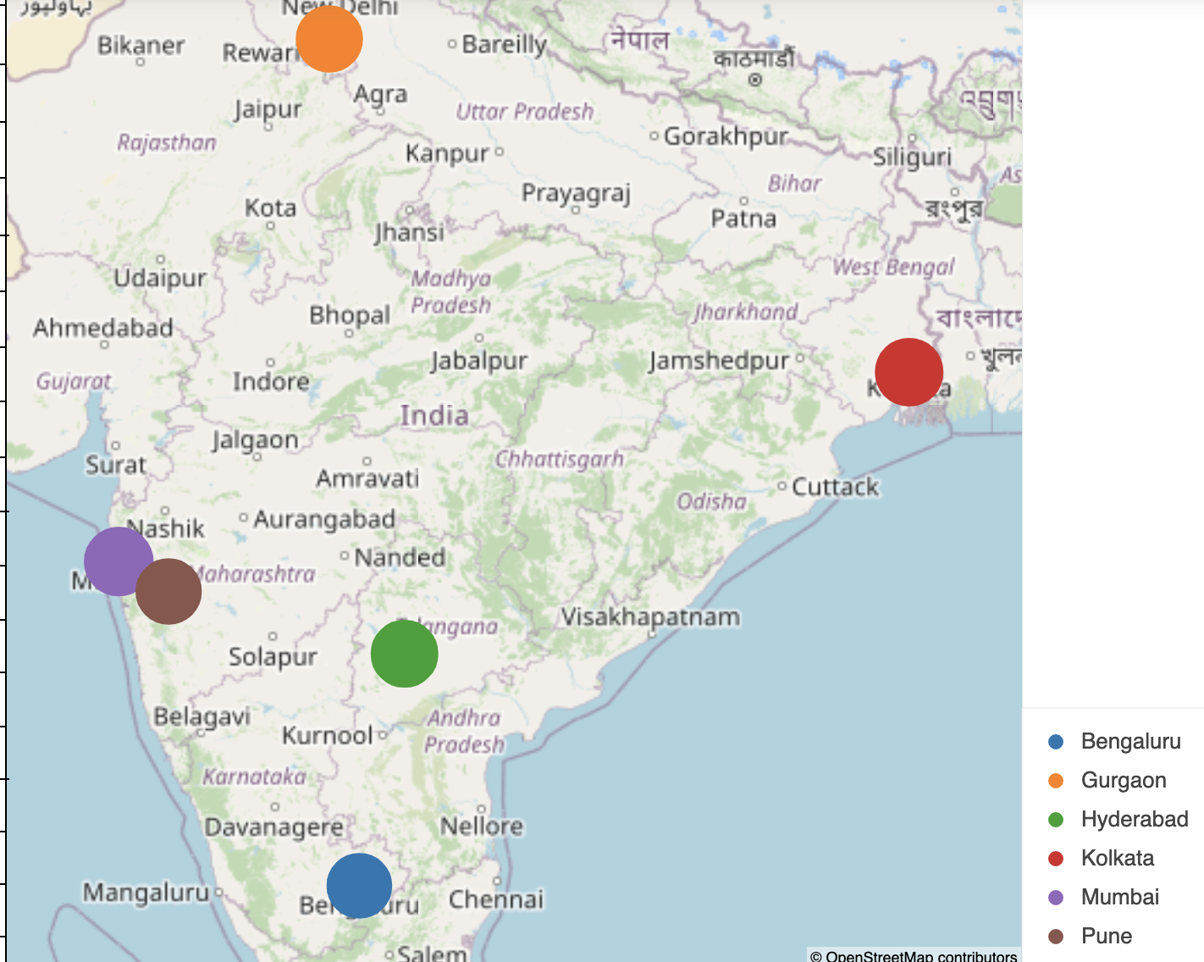
Average Salary by Location
Average Salary:
Mumbai → $4,476
Kolkata → $4,352
Hyderabad → $4,243
Gurgaon → $4,153
Pune → $4,053
Bengaluru → $3,969

Slide 4
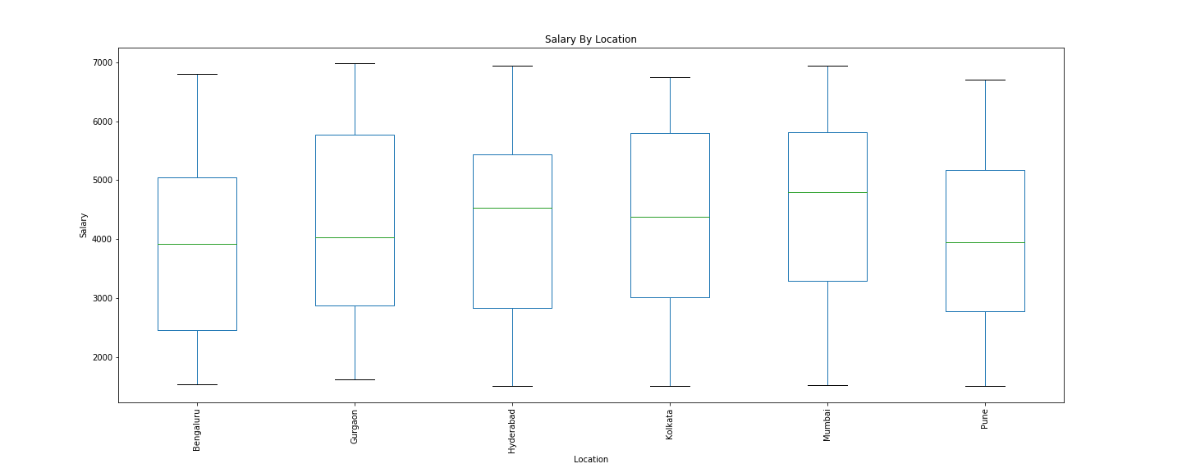
Salary Range By Location

Slide 5
Analysis Results
Mumbai has the most opportunity to find a job
Total of available positions 58
Mumbai has the highest top end range of salaried positions
Minimum Salary of $3,500
Maximum Salary of $5,900

